Slide 1
10- Filter Function

Slide 2
context
filter(function, iterable) : filterObject | the built in function 3
Ex.1 4
list(filterObject) | built in function 5

Slide 3
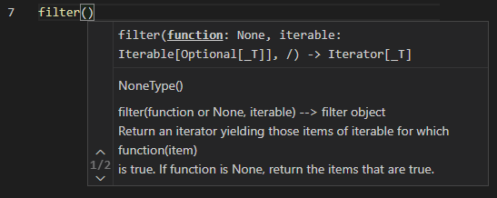
filter(function, iterable) : filterObject | the built in function
This filter function will apply this function on each item of this iterable.

Slide 4
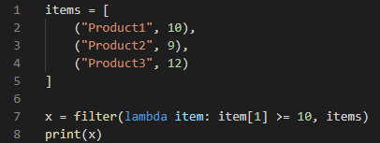
Ex.1
this filter function returns a filter object which is another iterable.

Slide 5
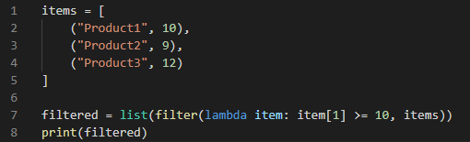
list(filterObject) | built in function
Earlier you learn that you can pass any iterables to this list function to create a new list

